Slide 1
A Survey on Educational Chatbot
Presentation 0
Date:01/12/2023
Batch Number:20CSEA003
Department of Computer Science and Engineering
Team Members:
V. Venkata Sai Anuhya(19K61A05G8)
V. Ganga Bhavani(20K61A05G9)
K. Manasa Lakshmi (20K61a0571)
S. Venkateswara Rao(20K61A05F3)
.
Supervisor
Dr. A V S Siva Rama Rao
Associate Professor

Slide 2

Problem Statement
Problems of Lack of Interaction and Engagement in Education.
To addresses the challanges faced by students in comprehending complex academic concepts, admissions process etc
An Educational chatbot offers a wide array of services as like assistance in Education

Slide 3
Purpose of the project
The purpose of a educational chat is to providing answers to student's questions within seconds.
Offer instant responses to queries
Access to Educational information and resources 24/7
Assist with administrative tasks within educational institutions
Can handle multiple user requests at once
Saves the time

Slide 4
Challenges available in solving the problem
❖ Accuracy:
Chatbots must be accurate in their responses. If they provide inaccurate
information, it can lead to confusion and frustration for students.
❖ Relevance:
Chatbots must be relevant to the students' needs. If they are not relevant,
students will not be engaged and they will not learn.
❖ Acceptance:
Chatbots must be accepted by students. If students do not trust or like the
chatbot, they will not use it.

Slide 5
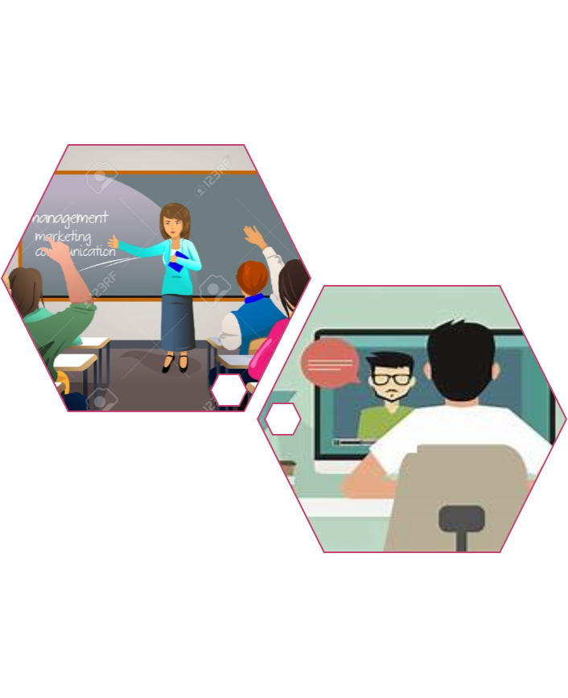
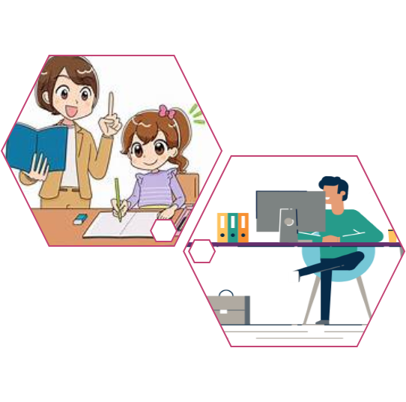
Existing solutions - Challenges already addressed
❑ Traditional textbooks and lectures
❑ One-on-one tutoring
❑ Discussion groups
❑ Online learning
❑ Self-paced learning
❑ Virtual classrooms

Slide 6
Unaddressed challenges
Understanding Emotions
Incorporating emotional intelligence into chatbot interactions to detect and appropriately respond to users' emotions, providing empathetic support where necessary.
Multilingual and Multicultural Support
Even if the proposed method is effective in predicting driver drowsiness, it may not be widely adopted if drivers are not willing to use it or if it is too intrusive.

Slide 7
AIM & Objective
AIM
The aim of an educational chatbot is to provide personalized, accessible, and engaging learning support through interactive conversations for users in the educational ecosystem.
Objectives
24/7 Personalized assistance accessibility
Continuous Improvement of student
Ethical and Inclusive Learning

Slide 8
Applications
Teaching Assistants: Assisting educators with resources, teaching strategies, and information related to professional development and training.
Course Scheduling: Assisting college or university students with course selection, academic guidance, and career-related queries.
Admission process: Aiding with administrative tasks such as course enrollment, scheduling, and providing information about educational programs or resources.
Exam Preparation: Offering practice tests, quizzes, and feedback to help students prepare for exams or assessments.

Slide 9
Significance
Motivation and encouragement
This application saves time
Chatbots are easy to use and convenient
Personalized learning experiences
Can handle multiple customer requests at once

Slide 10
Dataset
To train the educational chat a large amount of data is required
Educational datasets for chatbot development can be found on platforms like Kaggle, UCI Machine Learning Repository, educational institutions' databases, government data portals, and through research publications or EdTech companies.
The dataset from Kaggle include JSON file contain information about University Inquiry and also consists of two Excel sheets that contain two columns one is text and another is intent.

Slide 11
Novelty
Novelty indicates that the proposed method introduces something new from existing approaches.
Versatile Teaching Assistants: Beyond exam support, chatbots act as intelligent teaching assistants, providing real-time assistance and personalized guidance.
Integrated Solutions: Chatbots seamlessly integrate across multiple educational functions, offering a holistic approach to challenges.
Efficient Admissions Assistance: In the admissions process, chatbots efficiently guide prospective students with course details and application procedures

Slide 12
Summary
Chatbots revolutionize education by assisting students in exam preparation, offering instant feedback, and automating grading.
Serving as virtual teaching assistants, they answer questions, provide resources, and guide students through problem-solving.
In admissions, they assist prospective students with course details and application processes.
Additionally, chatbots contribute to personalized learning by tailoring materials to individual preferences, creating a more efficient and student-centric educational environment

Slide 13


